Slide 1
Department of Computer Science and Engineering
JP Nagar, Kothanur, Bengaluru - 560076
Quantum-Secure File Transfer Cryptography
Academic year 2025– 2026
Major Project Phase 2(BCS786)
Review -1
Presented by:
Bhuvana M L - 1RF23CS049
Nandini G V – 1RF23CS099
Narasani Chiruhaas Reddy – 1RF23CS100
Omkar Bhowmick – 1RF23CS105
Under the Guidance of:
Dr. Anil Kumar
Assistant Professor
Dept. of CSE
RVITM

Slide 2
Contents
  Introduction
  Problem Statement
  Literature Survey
  Methodology
  Results
  References

Slide 3
INTRODUCTION
What is Quantum Cryptography?
Quantum cryptography uses principles of quantum mechanics to secure communication against future quantum attacks.
Traditional cryptographic systems such as RSA and ECC are vulnerable to:
Shor’s Algorithm
Quantum factorization attacks
Quantum Key Distribution (QKD) enables:
Secure quantum key exchange
Detection of eavesdropping
Future-proof communication security
AES is used for efficient encryption of file data after secure quantum key generation.

Slide 4
Problem Statement
Problem Definition
Current secure communication systems rely on classical cryptographic methods vulnerable to quantum computing attacks.
Need for Quantum-Secure Communication
Existing systems:
Depend on RSA/ECC
Cannot resist future quantum attacks
Lack efficient secure key lifecycle handling
Existing Issues
Frequent key generation increases overhead
Repeated encryption operations reduce efficiency
Existing QKD systems lack optimized key management
Proposed Need
A practical quantum-secure file transfer system using:
BB84 Quantum Key Distribution
AES encryption
Efficient key lifecycle management

Slide 5
LITERATURE SURVEY
Year | Title | Author(s) | Description | Advantages | Drawbacks
2026 | Secure Quantum Communication: Simulation and Analysis of QKD Protocols | Mahendra Rasay et al. | Simulation of BB84, B92 and E91 using Qiskit. [1] | Real quantum circuit implementation | No file transfer optimization
2025 | Advances in Quantum Key Distribution Protocols | Y. Zhang et al. | Comparative study of modern QKD protocols and quantum communication techniques. [2] | Strong QKD analysis and security evaluation | No practical encryption integration
2025 | Qiskit-Based Quantum Communication System Simulation | A. Sharma et al. | Implementation of quantum communication using Qiskit simulator. [3] | Practical quantum circuit deployment | No key lifecycle optimization
2024 | Quantum Cryptography and Network Security Survey | R. Patel et al. | Survey of quantum-secure communication models and threats. [4] | Strong theoretical foundation | No implementation framework
1984 | Quantum Cryptography: Public Key Distribution and Coin Tossing | C. H. Bennett and G. Brassard | Original BB84 Quantum Key Distribution protocol. [5] | Foundation of quantum cryptography | Initial theoretical proposal only

Slide 6
Project Objectives
Primary Objective
Develop a quantum-secure file transfer system using BB84 Quantum Key Distribution and AES encryption.
Secondary Objectives
Implement real quantum circuit simulation using Qiskit
Generate AES session keys using QKD
Develop efficient Key Lifecycle Management
Implement secure client-server communication
Reduce redundant quantum key generation overhead
Research Gap
Existing QKD systems do not provide optimized key lifecycle management for repeated secure file transfer operations.

Slide 7
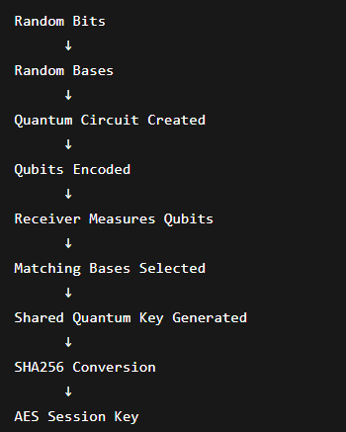
PROPOSED SYSTEM
System Overview
A client-server based secure communication system using:
Qiskit quantum circuits
BB84 QKD protocol
AES encryption
Key Manager module
Key Features
Quantum-derived session keys
AES encrypted file transfer
Time-based key expiry
Usage-based key reuse
GUI-based interaction

Slide 8
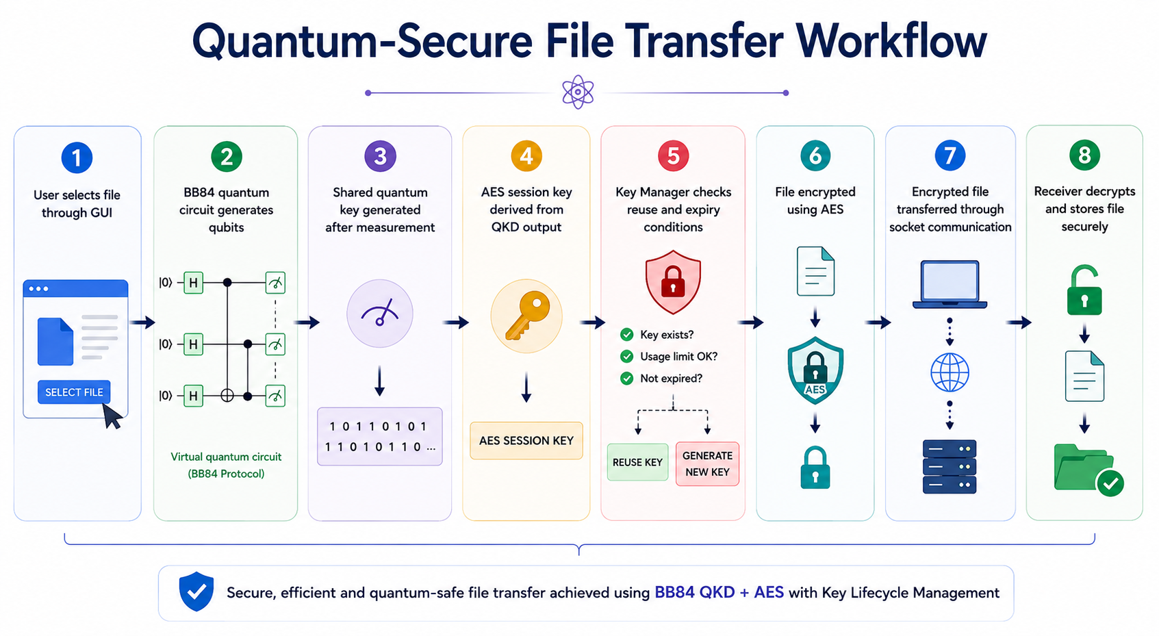

Slide 9
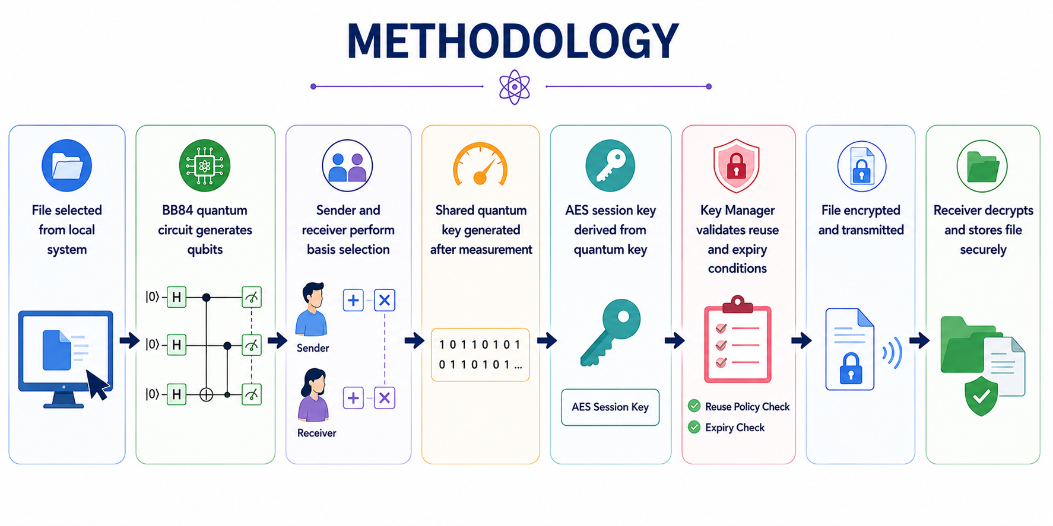

Slide 10
MODULES
Module | Function
GUI Module | Handles user interaction and file selection
QKD Module | Generates quantum-derived shared key
Quantum Circuit Module | Creates and measures qubits
AES Module | Encrypts and decrypts file
Key Manager | Controls key reuse and expiry
Client Module | Sends encrypted file
Server Module | Receives and decrypts file

Slide 11
Novelty of Proposed Work
Proposed Contribution
Design of an efficient key lifecycle management system integrated with BB84-based quantum key generation.
Key Innovations
Real Qiskit-based quantum circuit implementation
Controlled reuse of QKD-generated AES session keys
Time-based key expiry
Usage-based key lifecycle management
Impact
Reduced quantum key generation overhead
Improved repeated secure transfer performance
Practical integration of QKD with communication systems

Slide 12
IMPLEMENTATION
Completed Work
GUI-based file transfer interface implemented
BB84 quantum circuit implemented using Qiskit
Qubit generation and measurement completed
AES encryption/decryption module integrated
Client-server communication established using sockets
Key Manager module developed and tested
Tools Used
Python
Qiskit
Qiskit Aer Simulator
Socket Programming
Cryptography Library
Future Work
Multi-user secure communication
Real network deployment
Performance benchmarking
Eavesdropping simulation and analysis

Slide 13
RESULTS
Observations:
BB84 quantum key generation successful
AES encryption integrated successfully
Key reuse mechanism functioning correctly
Reduction in redundant quantum key generation
Successful encrypted secure file transfer achieved
Transfer | Key Status
1st | New Quantum Key Generated
2nd | Quantum Key Reused
3rd | New Quantum Key Generated

Slide 14
REFERENCES
[1] M. Rasay et al., “Secure Quantum Communication: Simulation and Analysis of Quantum Key Distribution Protocols,” arXiv preprint, 2026.
[2] Y. Zhang et al., “Advances in Quantum Key Distribution Protocols,” IEEE Access, 2025.
[3] A. Sharma et al., “Qiskit-Based Quantum Communication System Simulation,” Springer, 2025.
[4] R. Patel et al., “Quantum Cryptography and Network Security Survey,” Elsevier, 2024.
[5] C. H. Bennett and G. Brassard, “Quantum Cryptography: Public Key Distribution and Coin Tossing,” IEEE International Conference on Computers, Systems and Signal Processing, 1984.
[6] M. A. Nielsen and I. L. Chuang, Quantum Computation and Quantum Information, Cambridge University Press, 2010.
[7] IBM Quantum, “Qiskit Documentation,” 2025.

Slide 15
Thank You!

